Slide 1

Large-scale computational design and selection of polymers for solar cells
Dr Noel O’Boyle & Dr Geoffrey Hutchison
ABCRF
University College Cork
Department of Chemistry
University of Pittsburgh
Smart Surfaces 2012: Solar & BioSensor Applications
Dublin
6-9 March 2012
[This version edited for web]

Slide 2
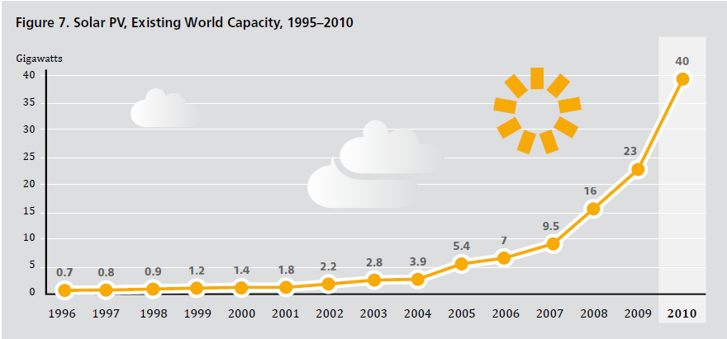
Ren 21, 2011. Renewables 2011 Global Status Report.
Solar photovoltaics is the world’s fastest growing power-generation technology.
- In the EU, 2010 was the first year that more PV than wind capacity was added.
Majority of capacity is silicon-based solar cells
- Costly to produce, materials difficult to source (on large scale)
Alternatives such as polymer solar cells hold promise of cheaper electricity.
Notes:
In terms of overall capacity globally:
ocean << geothermal < solar PV < solar heating < wind < hydropower
6MW << 11GW < 40 < 185 < 198 < 1010

Slide 3
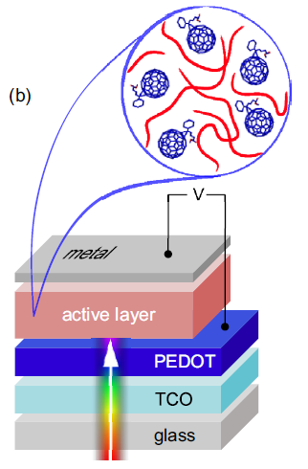
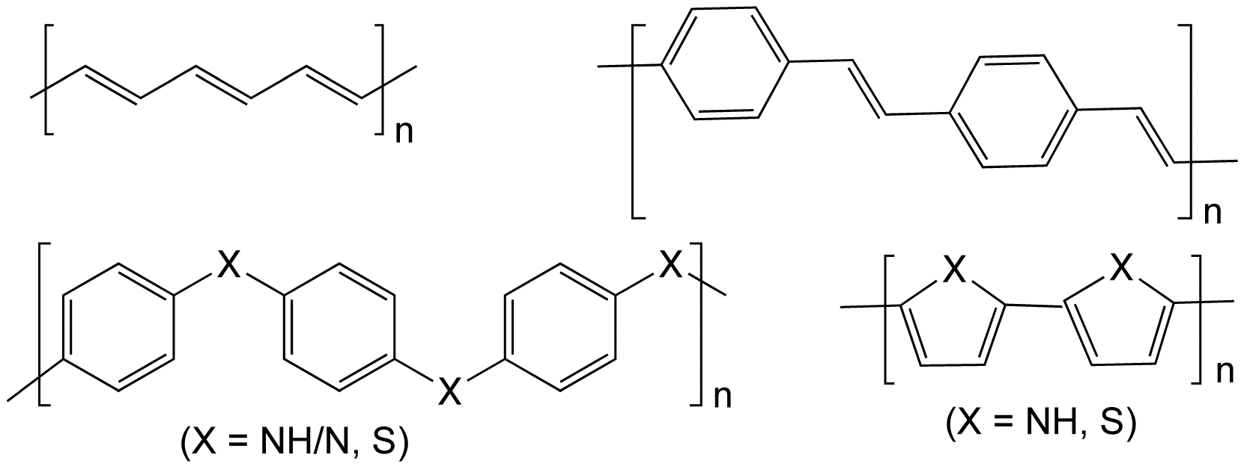
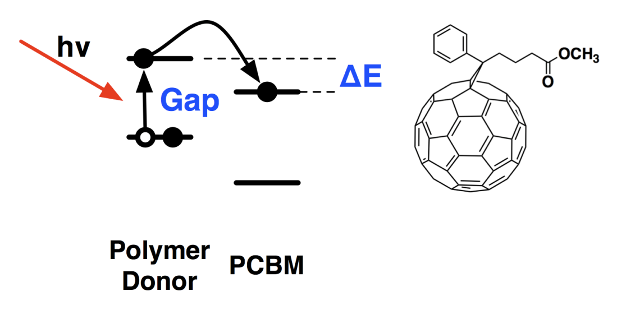
Conductive Polymers
2000 Nobel Prize in Chemistry “for the discovery and development of conductive polymers”
  Alan J. Heeger, Alan G. MacDiarmid and Hideki Shirakawa
Applications in LEDs and polymer solar cells
  Low cost, availability of materials, better processability
  But not yet efficient enough...
Notes:
TCO – transparent conducting oxide
PEDOT - Poly(3,4-ethylenedioxythiophene)
PCBM – Phenyl-C61-butyric acid methyl ester

Slide 4
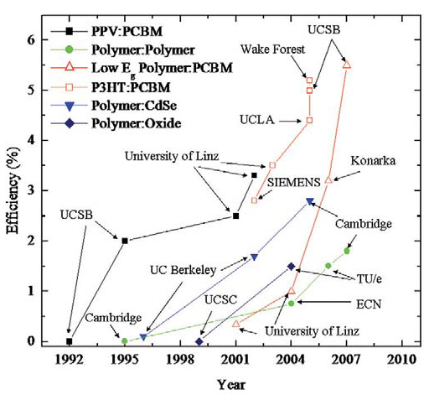
Efficiency improvements over time
McGehee et al. Mater. Today, 2007, 10, 28
Notes:
Efficiency = ratio of maximum power (FF.i(sc).V(oc)) to incident radiant power

Slide 5
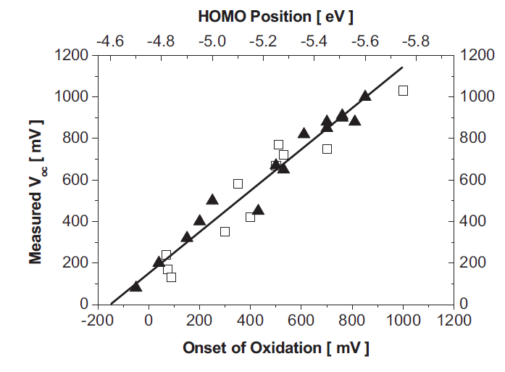
“Design Rules for Donors in Bulk-Heterojunction Solar Cells”
Scharber, Heeger et al, Adv. Mater. 2006, 18, 789

Slide 6
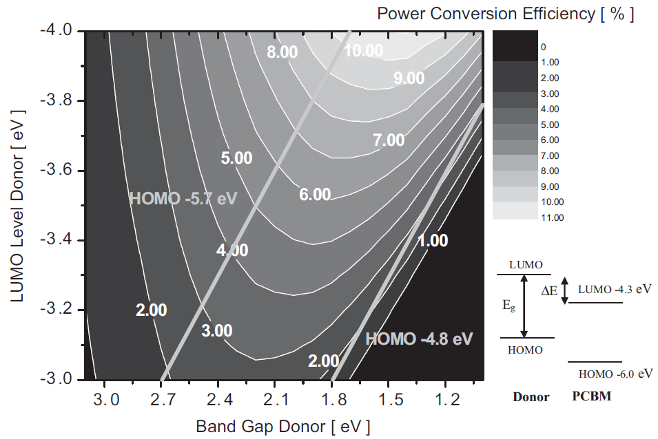
“Design Rules for Donors in Bulk-Heterojunction Solar Cells”
Max is 11.1%
Band Gap 1.4eV
LUMO -4.0eV
(HOMO -5.4eV)
Scharber, Heeger et al, Adv. Mater. 2006, 18, 789

Slide 7
Now we know the design rules...
...but how do we find polymers that match them?
Large-scale computational design and selection of polymers for solar cells

Slide 8
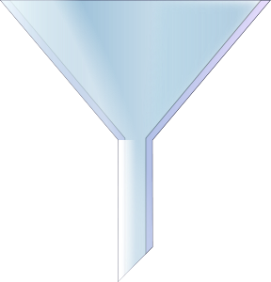
Computer-Aided Drug Design
Library of in-house compounds
Library of commercially-available compounds
Virtual library
Substructure filter
Similarity search
Docking
Priority list of compounds for experimental testing as drug candidates
Notes:
132 monomers

Slide 9
Computer-Aided Drug Design
Screening for Highly-Efficient Polymers
Library of in-house compounds
Library of commercially-available compounds
Virtual library
Library of all possible polymers?
Substructure filter
Similarity search
Docking
Calculate HOMO, LUMO
% Efficiency
Priority list of compounds for experimental testing as drug candidates
Priority list of compounds for experimental testing in solar cells
Notes:
132 monomers

Slide 10
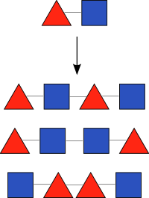
132 monomers
Screening for Highly-Efficient Polymers
Library of all possible polymers?
768 million tetramers!
59k synthetically-accessible
Calculate HOMO, LUMO
% Efficiency
Priority list of compounds for experimental testing in solar cells
Notes:
132 monomers

Slide 11
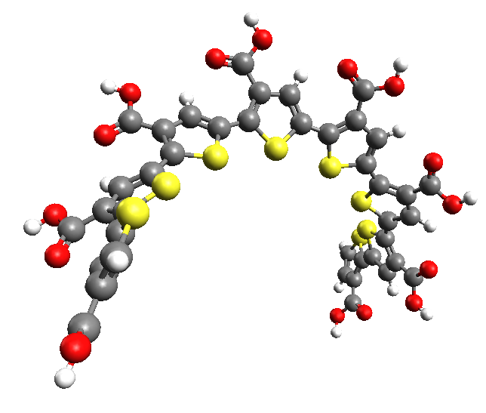
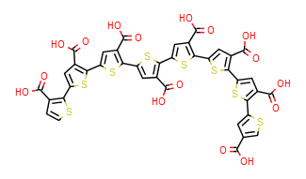
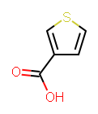
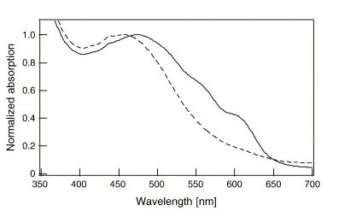

Open Babel^{1,2}
Open Babel
MMFF94
Gaussian
PM6
cclib³
Gaussian
% Efficiency
ZINDO/S
Slower calculations such as charge mobility
Electronic transitions
Predicted Efficient Polymers
[1] O'Boyle, Banck, James, Morley, Vandermeersch, Hutchison. J. Cheminf. 2011, 3, 33.
[2] O'Boyle, Morley, Hutchison. Chem. Cent. J. 2008, 2, 5.
[3] O'Boyle, Tenderholt, Langner. J. Comp. Chem. 2008, 29, 839-845.

Slide 12
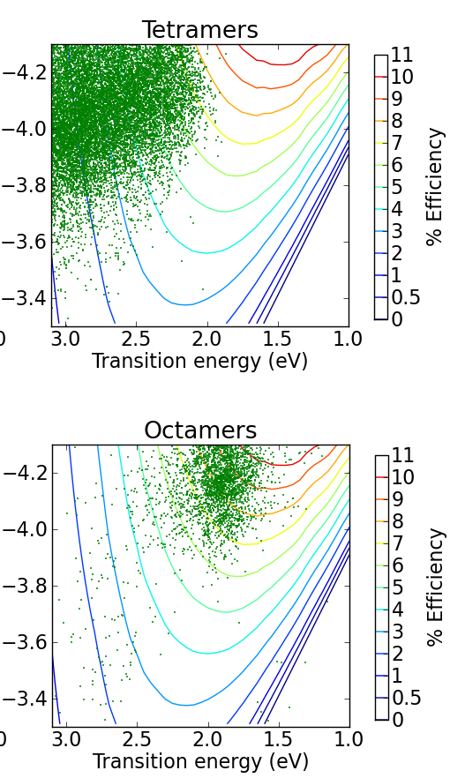
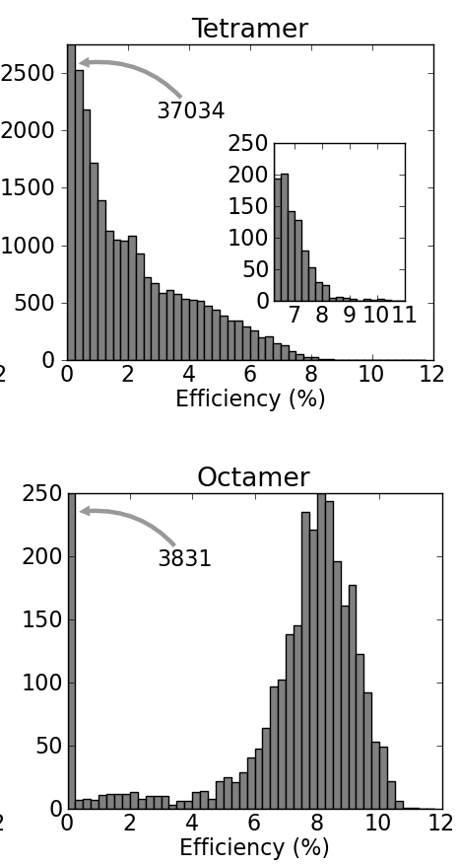
Excited state (eV)
Counts
Excited state (eV)
Counts

Slide 13
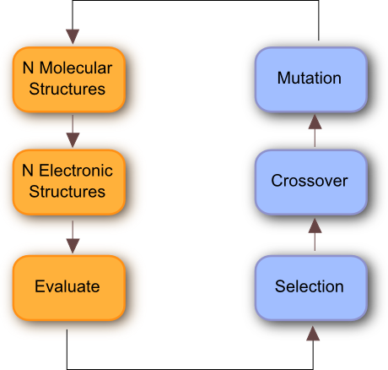
Excited state (eV)
Counts
Number of accessible octamers: 200k
  Calculations proportionally slower
  Brute force method no longer feasible
Solution: use a Genetic Algorithm to search for efficient octamers
  Find good solutions while only searching a fraction of the octamers
  7k octamers calculated (of the 200k)
Excited state (eV)
Counts

Slide 14
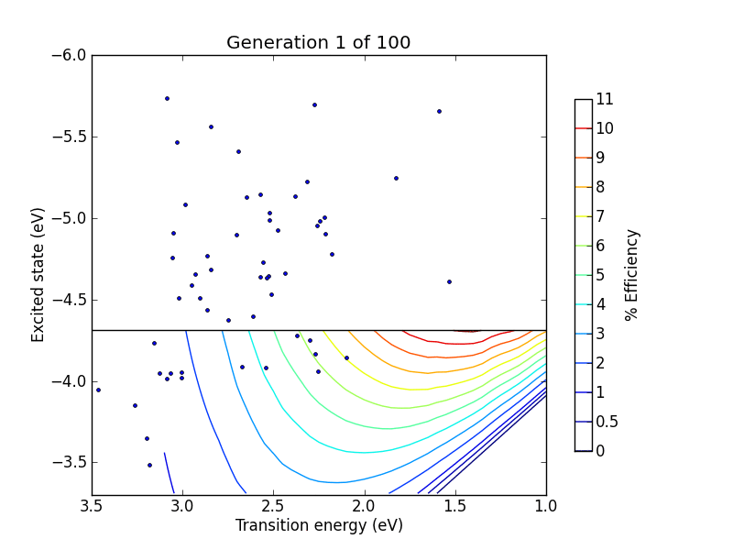

Slide 15
Excited state (eV)
Counts
Excited state (eV)
Counts

Slide 16
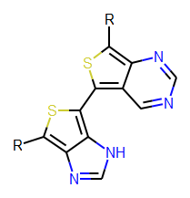
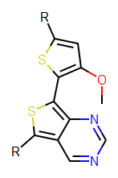
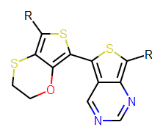
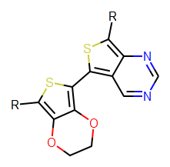
524 > 9%, 79 > 10%, 1 > 11%

Slide 17
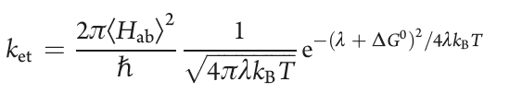
524 > 9%, 79 > 10%, 1 > 11%
Filter predictions using slower calculations
Eliminate polymers with poor charge mobility
  Reorganisation energy (λ) is a barrier to charge transport
  Here, internal reorganisation energy is the main barrier
  λ_{int} = (neutral@cation - neutral) + (cation@neutral - cation)

Slide 18
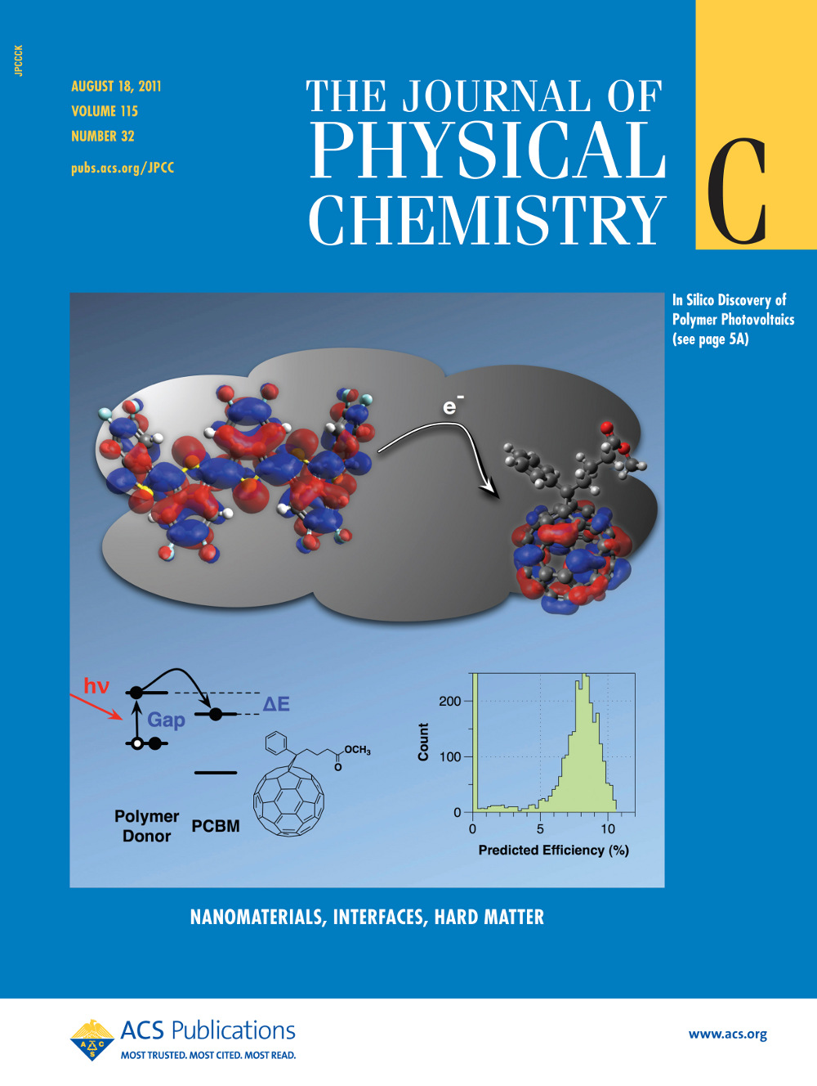
O’Boyle, Campbell, Hutchison.
J. Phys. Chem. C. 2011, 115, 16200.
First large-scale computational screen for solar cell materials
A tool to efficiently generate synthetic targets with specific electronic properties (not a quantitative predictive model for efficiencies)
...this is just the first step

Slide 19



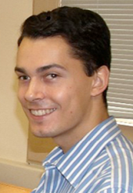

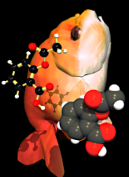

Large-scale computational design and selection of polymers for solar cells
Funding
Health Research Board Career Development Fellowship
Irish Centre for High-End Computing
University of Pittsburgh
Dr. Geoff Hutchison
Casey Campbell
Open Source projects
Open Babel (http://openbabel.org)
cclib (http://cclib.sf.net)
n.oboyle@ucc.ie
http://baoilleach.blogspot.com
Image: Tintin44 (Flickr)

Slide 21
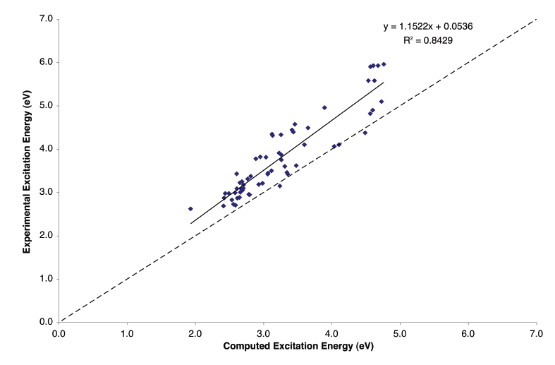
Accuracy of PM6/ZINDO/S calculations
Test set of 60 oligomers from Hutchison et al, J Phys Chem A, 2002, 106, 10596
Notes:
Within 1.0

Slide 22
Searching polymer space using a Genetic Algorithm
An initial population of 64 chromosomes was generated randomly
  Each chromosome represents an oligomer formed by a particular base dimer joined together multiple times
Pairs of high-scoring chromosomes (“parents”) are repeatedly selected to generate “children”
  New oligomers were formed by crossover of base dimers of parents
  E.g. A-B and C-D were combined to give A-D and C-B
Children are mutated
  For each monomer of a base dimer, there was a 75% chance of replacing it with a monomer of similar electronic properties
Survival of the fittest to produce the next generation
  The highest scoring of the new oligomers are combined with the highest scoring of the original oligomers to make the next generation
Repeat for 100 generations

